Slide 1
Switching
Linear Circuit Analysis II
EECE 202

Slide 2
Announcement
GCA2 – Group Week 11 Lecture 2
PD2 (Technical Report) due Thursday Week 12

Slide 3
Recap
Equivalent circuit for capacitors in s domain
Equivalent circuit for Inductors in s domain
Examples
New Material
Switching
Series combination
Parallel combination

Slide 4
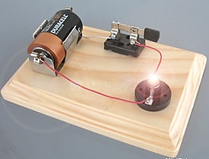
Switching
Switches
In electrical engineering, a switch is an electrical component that can disconnect or connect the conducting path in an electrical circuit, interrupting the electric current or diverting it from one conductor to another.
The most common type of switches is an electromechanical device consisting of one or more sets of movable electrical contacts connected to external circuits. When a pair of contacts is touching, current can pass between them, while when the contacts are separated no current can flow.

Slide 5
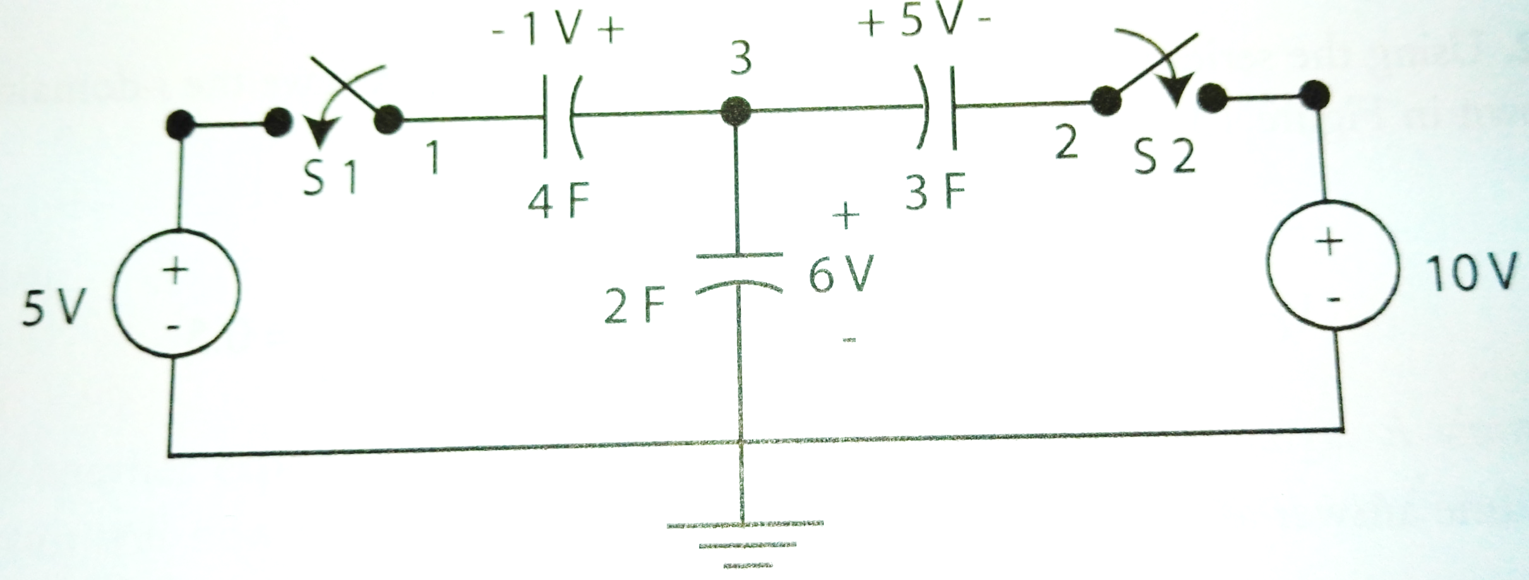
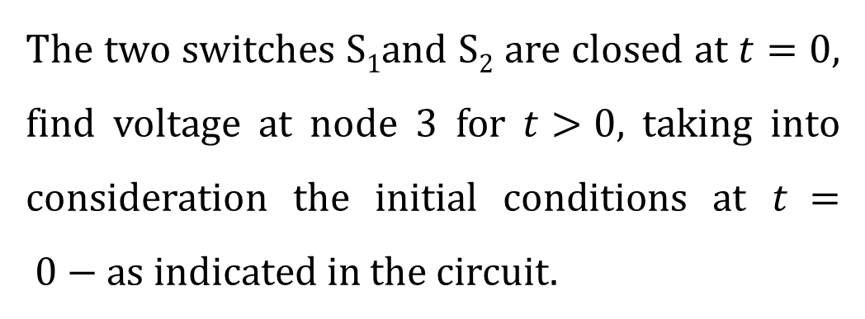
Example -1
The two switches S₁and S₂ are closed at $t=0$, find voltage at node 3 for $t>0$, taking into consideration the initial conditions at $t = 0−$as indicated in the circuit.
admittance
Notes:
This is example 13.20 from the book, page 648

Slide 6
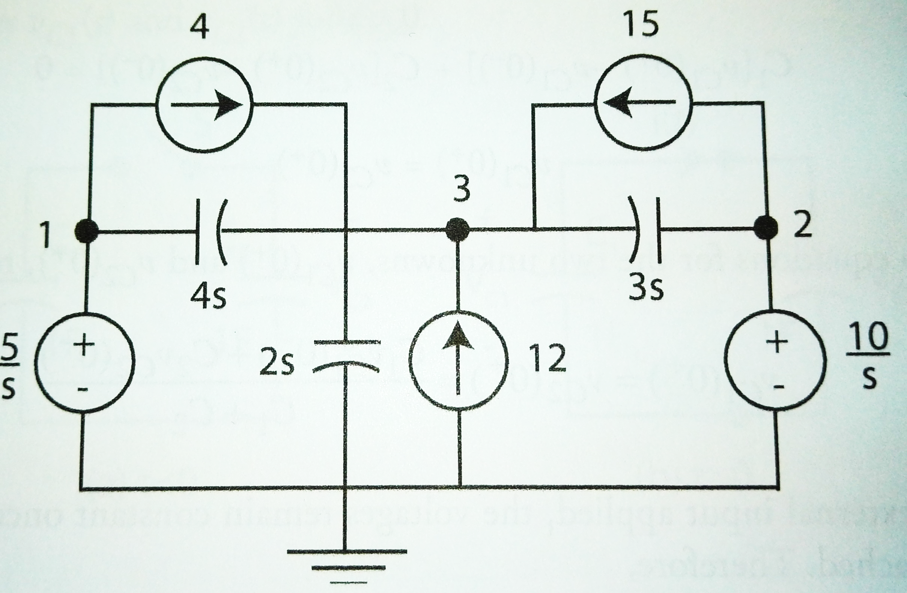
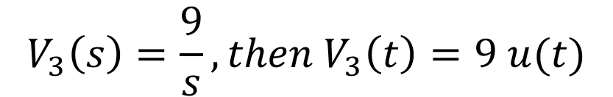
Example -1 cont.
First, find the circuit in the s domain
Then, apply KCL at node 3:
$$4s×\left(V_{3}−\frac{5}{s}\right)+3s×\left(V_{3}−\frac{10}{s}\right)+2s×V_{3} =4+15+12$$
$$V_{3}\left(s\right)=\frac{9}{s}, then V_{3}\left(t\right)=9 u(t)$$

Slide 7
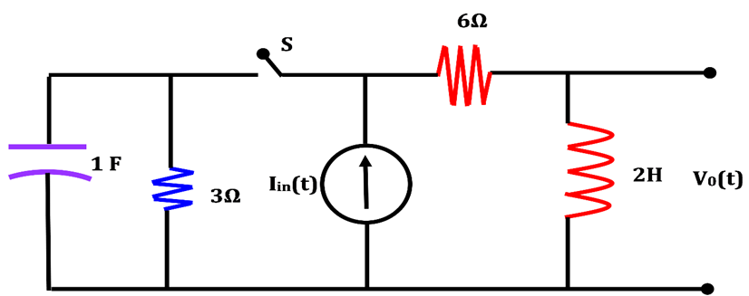
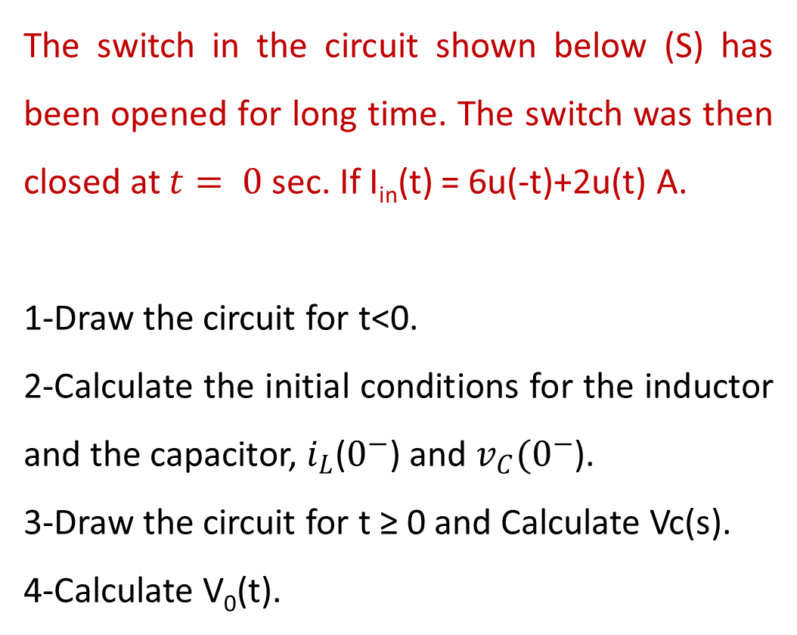
Example -2
The switch in the circuit shown below (S) has been opened for long time. The switch was then closed at $t= 0$sec. If I_{in}(t) = 6u(-t)+2u(t) A.
1-Draw the circuit for t<0.
2-Calculate the initial conditions for the inductor and the capacitor, $i_{L}$($0^{−}$) and $v_{C}{(0}^{−}$).
3-Draw the circuit for t ≥ 0 and Calculate Vc(s).
4-Calculate V₀(t).
2 Ω
0.5 F
2 Ω

Slide 8
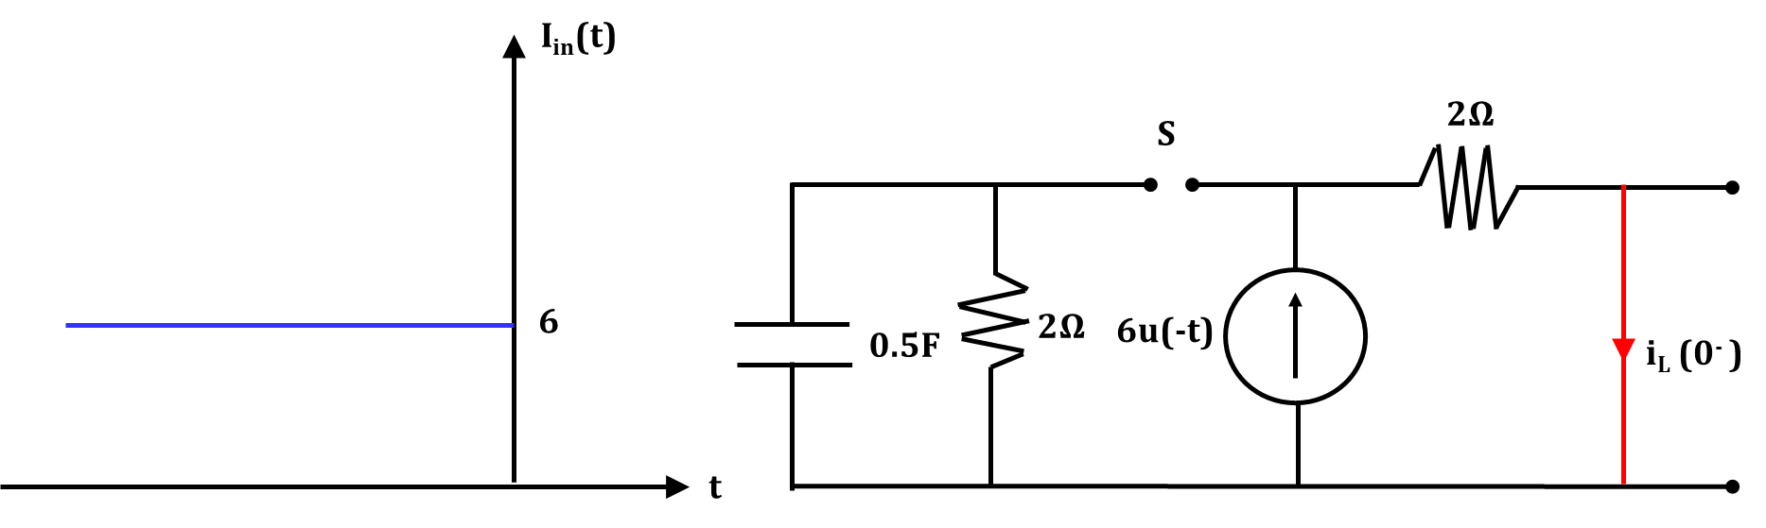
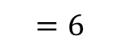
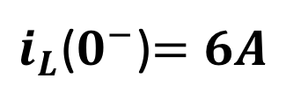
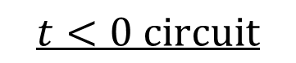
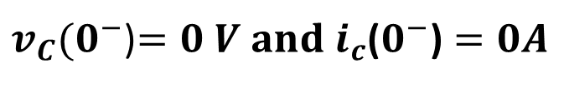
Solution
1. First, we draw the circuit at t<0 when the switch S was open
$$t<0 circuit$$
$$=6$$
2. Calculate the initial condition of the inductor, $i_{L}$($0^{−}$). From the above circuit, $i_{L}$($0^{−}$)=I_{in}(t)
$i_{L}$($0^{−}$)$=6A$
3. The initial condition for the capacitor $v_{C}{(0}^{−}$)$=$0 V, since there is no current in the capacitor circuit.
$v_{C}{(0}^{−}$)$=0 V and i_{c}\text{(}0^{−}\text{)}=0A$

Slide 9
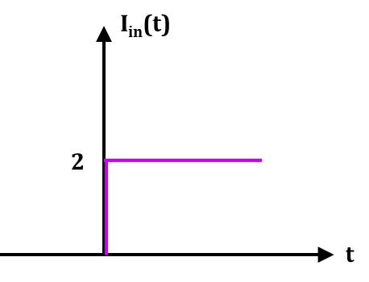
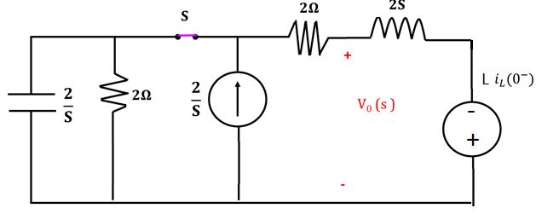
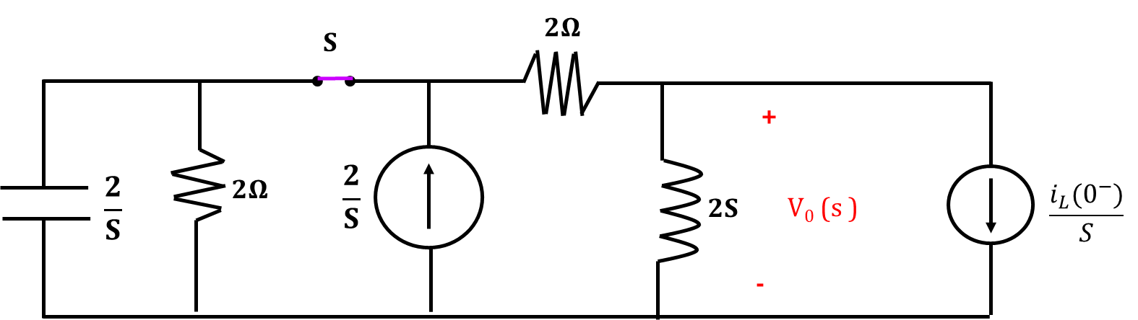
4. Now At t ≥0, switch S is closed and the value of I_{in}(t)=2 A (as shown in the figure)
5. Capacitor and the inductor should be replaced with their equivalent circuits.
6. We have two options to redraw the circuit, we can use either the parallel combination for the initial or the series combination for the initial condition equivalent circuit.
Series combination
Parallel combination

Slide 10
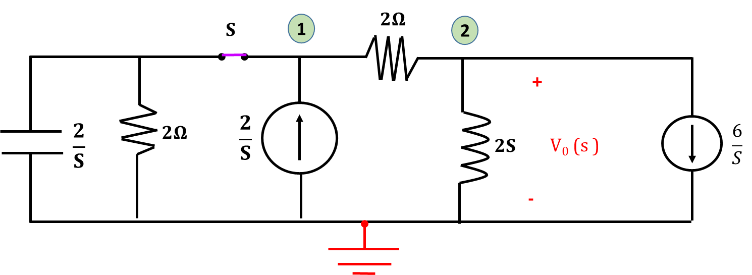
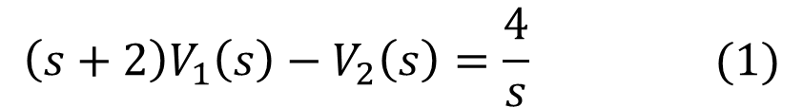
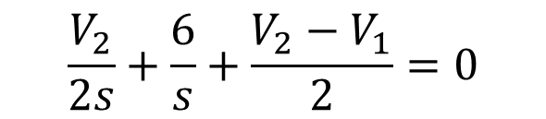
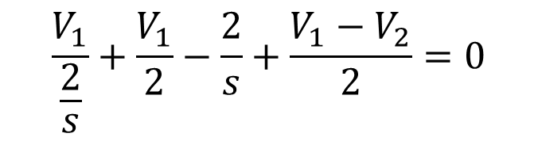
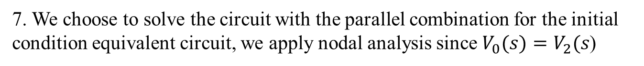
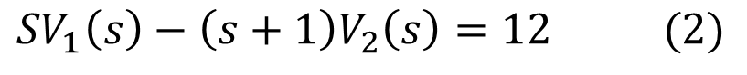
7. We choose to solve the circuit with the parallel combination for the initial condition equivalent circuit, we apply nodal analysis since $V_{0}(s)=V_{2}(s\text{)}$
By applying Nodal Analysis
Node 1
$$\frac{V_{1}}{\frac{2}{s}}+\frac{V_{1}}{2}−\frac{2}{s}+\frac{V_{1}−V_{2}}{2}=0$$
Node 2
$$\frac{V_{2}}{2s}+\frac{6}{s}+\frac{V_{2}−V_{1}}{2}=0$$
By simplifying the two equations, we obtain (1) and (2):
$${\left(s+2\right)V}_{1}\left(s\right)−V_{2}\left(s\right)=\frac{4}{s} (1)$$
$${SV}_{1}\left(s\right)−\left(s+1\right)V_{2}\left(s\right)=12 (2)$$

Slide 11
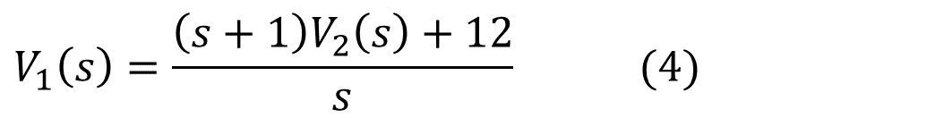
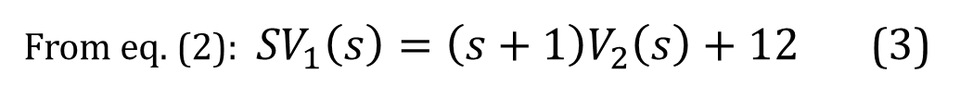
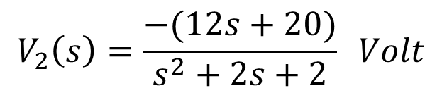
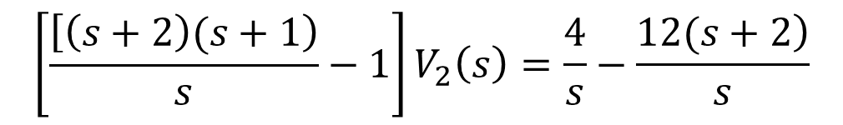
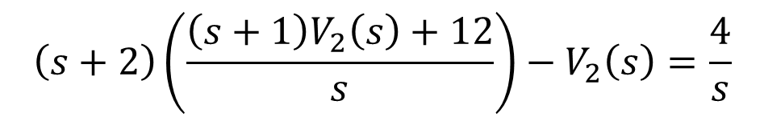
From eq. (2): ${ SV}_{1}\left(s\right)=\left(s+1\right)V_{2}\left(s\right)+12$ (3)
$$V_{1}\left(s\right)=\frac{\left(s+1\right)V_{2}\left(s\right)+12}{s} (4)$$
Substituting eq.(3)in eq.(1) we can calculate V2 (s) as:
$$\left(s+2\right)\left(\frac{\left(s+1\right)V_{2}\left(s\right)+12}{s}\right)−V_{2}\left(s\right)=\frac{4}{s}$$
$$\left[\frac{\left[\left(s+2\right)(s+1\right)}{s}−1\right]V_{2}\left(s\right)=\frac{4}{s}−\frac{\left.12(s+2\right)}{s}$$
After simplification, we obtain:
$$V_{2}\left(s\right)=\frac{−(12s+20)}{s^{2}+2s+2} Volt$$

Slide 12
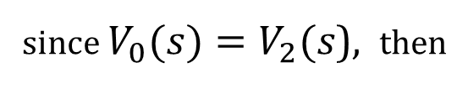
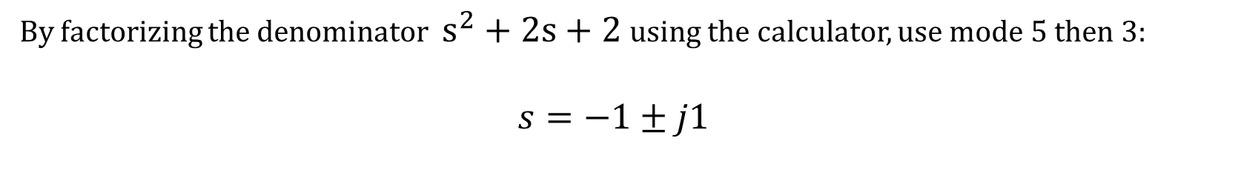
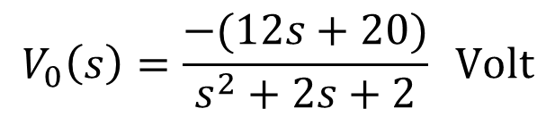
since $V_{0}(s)=V_{2}(s\text{)}$, then
$$V_{0}\left(s\right)=\frac{−(12s+20)}{s^{2}+2s+2} Volt$$
By factorizing the denominator $s^{2}+2s+2$ using the calculator, use mode 5 then 3:
$s=−1±j1$
a
b
$V_{0}\left(s\right)=\frac{−(12s+20)}{{\left(s+a\right)}^{2}+b^{2}}$ = $\frac{−(12s+20)}{{\left(s+1\right)}^{2}+1}$= $\frac{−(12s+12+8)}{{\left(s+1\right)}^{2}+1}$= - $\frac{12(s+1)}{{\left(s+1\right)}^{2}+1}$ - $\frac{8}{{\left(s+1\right)}^{2}+1}$
$$v_{0}\left(t\right)=−12e^{−t}cos\left(t\right)u(t)−8e^{−t}\sin\left(t\right)u\left(t\right) Volts$$

Slide 13
Answer the following questions using ChatGPT
How do you analyze a circuit before and after the switching event?
Why is it necessary to consider initial conditions for capacitors and inductors during switching analysis?
When should you use the series combination versus the parallel combination for initial condition equivalent circuits?
How are capacitors and inductors represented in the s-domain during switching analysis?
What happens to the energy stored in a capacitor or inductor during a switching event?

Slide 14
Summary
A switch is an electrical component that can connect or disconnect a conducting path in a circuit, controlling the flow of current.
When analyze the circuit with the switch open, components such as capacitors and inductors retain their initial conditions.
When analyze the circuit with the switch closed, redraw the circuit and replace capacitors and inductors with their equivalent s-domain representations.
Series Combination - Initial condition modeled with voltage sources.
Parallel Combination - Initial condition modeled with current sources.
Used in transient analysis when circuits switch between states.

